Slide 1
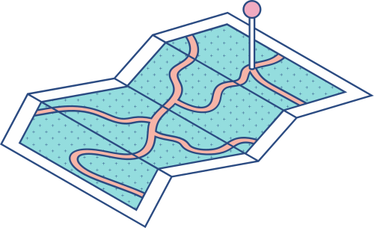





The Mobile payment based on public-key security technology
Aditya Shah & 202003045

Slide 2
Introduction
Mobile payment has established itself as a crucial component of e-commerce due to its high convenience and low cost. And hence I have to ensure the information security during the paying process.
What will I do in this PPT ?
First I will do a theoretical research on MPS(Mobile Payment System)
Then I will study the security mechanism of MPS(Mobile Payment System)
then I will see how the technology adapts to the market need by comparing the two applications' differences.

Slide 3
More on Mobile payment system ...
There are three primary operating modes :
mobile operators
banks
third-party service provider
When mobile operators act as the main body...
The mobile operator will utilize the mobile phone number as the account, and the department will deduct the user's credit account for the fees associated with mobile payment transactions.
There is no requirement for bank involvement, and it is hard to invoice the company that isn't phoning.
When the bank acts as the main body...
It links the bank account to the mobile account by connecting to the mobile communication network via a dedicated line. While mobile operators do not participate in the payment process, banks provide users trading platforms and payment channels.

Slide 4
More on Mobile payment system ...
Drawback of this method is that Mobile payment services cannot be networked betIen banks; instead, each bank can only provide services for users of its own bank.
When a third-party service provider comes into play,
it is a bridge and a connection betIen a merchant, a bank, and a mobile operator.
Due to users' access to various bank accounts on third-party service providers, third-party service providers are now playing a role in the merger of users and banks.
MPS is divided into two components :
MPA (Mobile Payment Agent)
MPP (Mobile Payment Platform)
(MPA and MPP are connected via da igital data network)
MPA is in charge of managing, accounting for, and communicating on a national level.
MPP is in charge of managing, accounting for, and communicating on a local level.

Slide 5
Symmetric-key Encryption
In this method to encrypt and decrypt the message in the communication, the sender and the receiver must share the same key. Hense symmetric key(shared key) encryption
Before to the transfer of data, keys should be exchanged betIen the communicating entities. The key exchange process is crucial for the encryption process.
Compared to longer keys that are more difficult to crack, Iaker, shorter keys are more vulnerable to attack.
DES ( Data Encryption Standard) is a famous symmetric encryption method. The National Bureau of Standards accepted DES in 1977. DES algorithms convert 64 bits of plaintext into 64 bits of cypher text as its output.

Slide 6
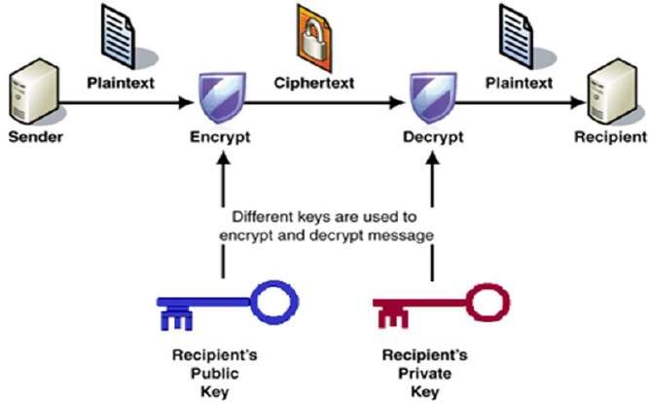
Public-key Encryption
Public-key (asymmetric) encryption is a field of cryptographic system which uses a pair of related keys.
Each pair consists of a public-key and a private-key.
In public-key encryption, anyone with public
key encrypts the message and yields a
ciphertext, on the other hand, only those who
have the corresponding private key can
decrypt the ciphertext and obtain the
original message.
The most widely used public-key cryptosystem
is RSA (Rivest–Shamir–Adleman).

Slide 7
Rivest-Shamir-Adleman (RSA)
The main idea of RSA system is based on the fact that the factorization of two large prime numbers is extremely difficult.
Being an asymmetric cryptography, it consists of two keys, public-key and private-key.
The public key (encryption) consists of two numbers, one number, lets say 'n', is a multiplication of two large prime numbers(p and q) and the other, lets say 'e', is a integer such that gcd(Φ(n),e)=1 and 1<e<Φ(n), where Φ(n) = (p-1)(q-1).
The private key is also derived from the same two prime numbers, so if someone factorizes the large number, they can easily obtain the private key.
Private key (decryption) is calculated by d = (k*Φ(n) + 1) / e, where k is some integer, i.e. k={1,2,3,.....}
RSA keys are mainly 1024 or 2048 bits long.

Slide 8
RSA - Example
Let two prime numbers be, P=53 and Q=59.
Therefore, first part of public key = n=P*Q = 3127 and Φ(n)=(p-1)(q-1) = 3016.
Let other part of the public key be equal to 3, i.e. e=3.
Now for private key, d = (k*Φ(n) + 1) / e, let k=2, therefore, d = 2011.
Public key n = 3127 and e = 3 and private key d = 2011
I will encrypt and decrypt 'HI', where H = 8 and I = 9.
Therefore, encrypted data, c = (89^e) mod n. Our encrypted data comes out to be 1394.
Now for decryption, decrypted data = (c^d) mod n, where c is the encrypted data, decrypted data comes out to be 89 which represents 8=H and 9=I, i.e. 'HI'.

Slide 9
Comparison
Symmetric Encryption | Asymmetric Encryption
Encryption and decryption is done using the same key. | It requires two keys, public key and private key, one to encrypt and the other to decrypt.
As same key is used, the encryption is very fast. | As two different keys are used, the encryption is slow.
Security offered by symmetric encryption is low because of a single key. | Security is high because of the use of two keys .
The complexity is low. | The complexity is high.

Slide 10
DIGITAL SIGNATURES

Slide 11
Introduction:
Digital Signatures
As the name suggests, Digital Signature is a mathematical technique which ensures non-repudiation, authenticity and integrity of data.
Authenticity: data is transmitted by the intended sender
Non-repudiation: receiver can show that the data was transmitted by the specific sender.
Integrity: receiver can verify whether data was tampered while transmission or not.

Slide 12
Creating Digital Signature
1. I can create digital signature by encrypting the HASH(message) with private key of the sender,(HASH(message)=apply hash function on message)
2. (message, digital signature) is transmitted.
3. Digital signature can be decrypted by the receiver using the public key of sender.(This assures authenticity, as only sender has his private key so only sender can encrypt using his private key which can thus be decrypted by sender’s public key).

Slide 13
Continued...
4. The receiver now has the HASH(message) by decrypting the signature.
5. The receiver can compute the HASH(message) from data he received as (message, digital signature) was sent.
6. If The HASH(message) computed by receiver and the HASH(message) obtained by decrypting the digital signature, are same, then I can say data was not tampered and thus provides data integrity.

Slide 14
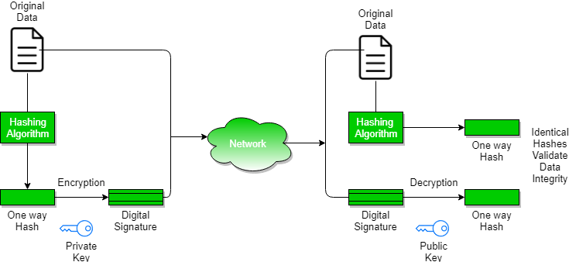
Working of digital Signature
source: https://www.geeksforgeeks.org/digital-signatures-certificates/

Slide 15
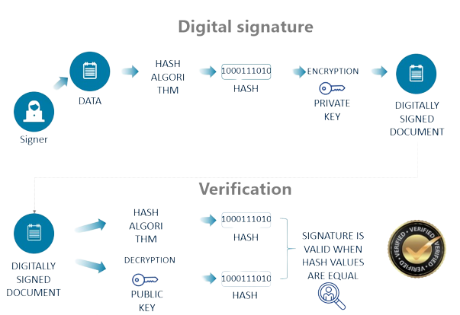

Slide 16
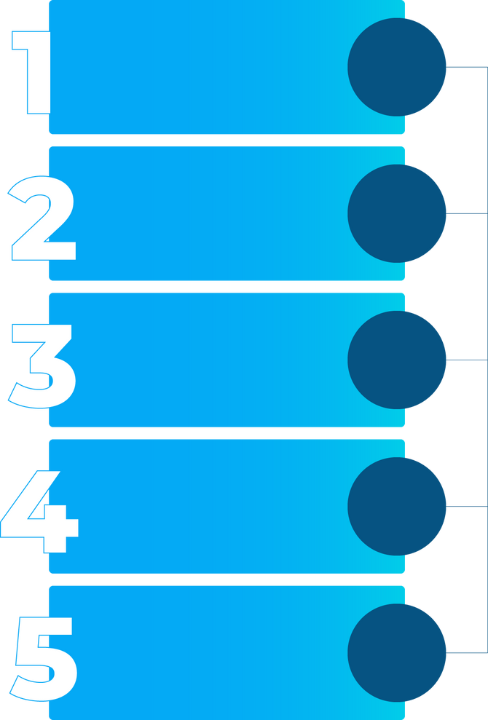
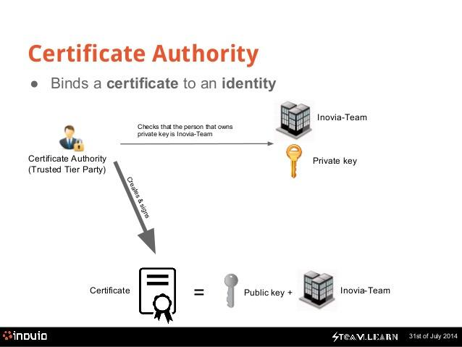

Certificate Authority
Generating key pairs
CA issues a certificate to a client and assists other users in verifying the certificate.
Issuing digital certificates
checks that the person that owns
private key is Inovia-Team
Publishing Certificates
Creates
and
signs
Verifying Certificates
Revocation of Certificates

Slide 17

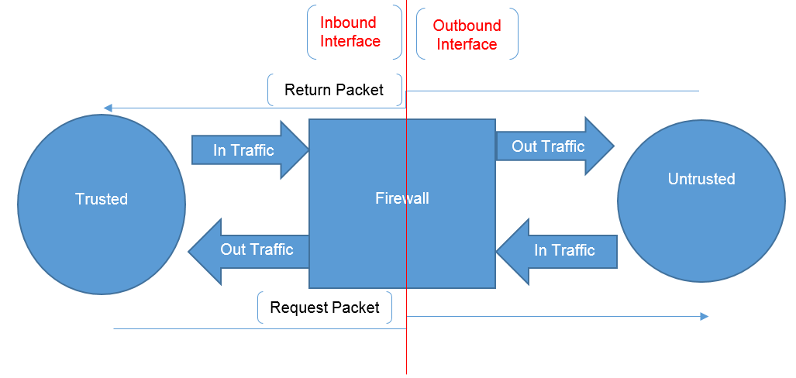
Firewall
A firewall permits access
to the outside world while defending a local system
or network against
network-based security
risks.
As it is challenging to
provide every device
with robust security capabilities, firewalls are often necessary.

Slide 18
Security Mechanism
Of QR Code
APPLICATION OF PUBLIC-KEY TECHNOLOGY IN BUSINESS MODE

Slide 19
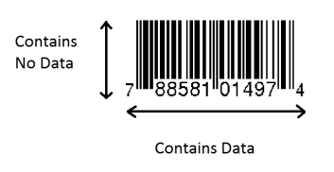
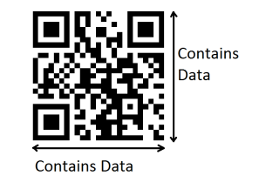
WHAT IS QR CODE?
QR("quick response") code is a two-dimensional bar code invented by the Japanese corporation Denso Wave.
It stores data horizontally as Ill as vertically. There are different versions of QR codes are available.
It stores data several hundred times more data than bar code.
One can access the data of the QR code by capturing a photograph of the QR code and processing using QR code reader.
Bar Code
QR Code
Source :
https://www.researchgate.net/publication/221593120_QR_code_security

Slide 20
WHY IS A SQUARE SHAPE FORM USED WITH QR CODES?
HIGHER DATA CAPACITY
The square shape allows QR codes to have reading horizontally and vertically. That means I can store lots of information in small square.
QR code can recover more damage than other code through its error correction capability. It can correct the error from 7% to 30%.
ERROR CORRECTION
EASY TO READ
To read any QR Code you only need to download QR code scanner app on laptop, desktop or tablet.
.

Slide 21
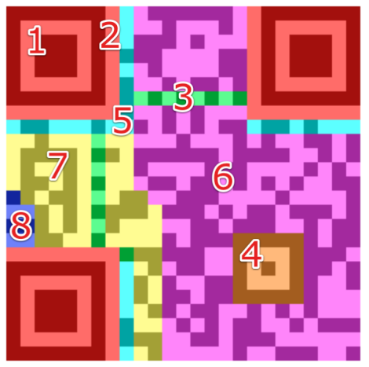
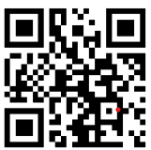
Structure of QR Code
To understand the structure of the QR code, I need to divide it into different parts as follows :
Finder Pattern
Separators
Timing Pattern
Alignment Patter
Format Information
Data
Error Correction
Version Information
Structure of QR Code version 2
Source :
https://www.researchgate.net/publication/221593120_QR_code_security

Slide 22
Structure of QR Code
1. Finder Pattern: The finder pattern consists of three identical structures that are located in all corners of the QR Code except the bottom right one. The Finder Patterns enable the decoder software to recognize the QR Code and determine the correct orientation.
2. Separators: The white separators are one pixel wide and increase the Finder Patterns' legibility by separating them from the real data.
Structure of QR Code version 2
Source :
https://www.researchgate.net/publication/221593120_QR_code_security

Slide 23
Structure of QR Code
3. Timing Pattern: The Timing Pattern can be used to decode the width of a single module by alternating betIen black and white modules.
4. Alignment Patterns: The decoder software uses alignment patterns to help it correct mild visual distortions.
5. Format Information: This section consists of 15 bits next to the separator and stores information about the error correction level.
Structure of QR Code version 2
Source :
https://www.researchgate.net/publication/221593120_QR_code_security

Slide 24
Structure of QR Code
6. Data: Data is converted into a bit stream and then stored in 8-bit parts (called codewords) in the data section.
7. Error Correction: Similar to the data section, error correction codes are stored in 8-bit long codewords in the error correction section.
8. Version Information: It stores the version of the QR Code there are 40 versions of QR codes available. They mainly differ in a number of modules.
Structure of QR Code version 2
Source :
https://www.researchgate.net/publication/221593120_QR_code_security

Slide 25
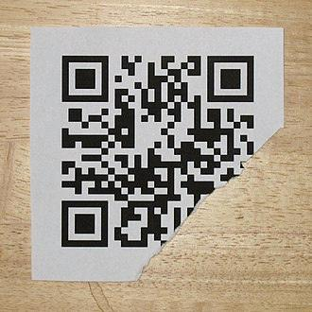
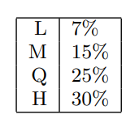
Error Correction
Suppose, the QR code is damaged as shown in the image but it can still be decoded using a QR scanner due to its error correction capability of it.
QR codes use Reed–Solomon error correction over the finite field of order 256.
The following table lists the approximate error correction capability at each of the four levels:
Low
Medium
Damaged QR Code
Quartile
High
Source :
https://en.wikipedia.org/wiki/QR_code

Slide 26
Error Correction Vs Data
Higher error correction levels increase the percentage of codewords used for error correction and therefore decrease the amount of data that can be stored inside the code.
In the given OR Code, the trade-off betIen the yellow and pink area occurs according to the error correction levels you want in your QR Code.
Structure of QR Code version 2

Slide 27



QR Code encryption through PKI
The QR Code encryption through PKI (public key Infrastructure) in mobile payment systems can be divided into the following seven steps:
1. Give User ID
USER
Merchant
7. Scan QR Code, decrypt using private Key & verify received message
2. Receive User ID
6. Generate QR Code uses Public Key
7. QR Code
3. Request public key
5. Authenticate and receive Private key
Third Party
5. Public key of User
4. Generate public key and private key based ID

Slide 28
References
Sun, Jiabin, and Nan Zhang. "The Mobile payment based on public-key security technology." Journal of Physics: Conference Series. Vol. 1187. No. 5. IOP Publishing, 2019.
https://educationplusindia.blogspot.com/2020/02/digital-certificate.html
https://nsc-tay.blogspot.com/2016/07/understanding-of-acl.html
https://www.certificatestemplatesfree.com/certificate-authority-2297.html
https://www.geeksforgeeks.org/difference-betIen-symmetric-and-asymmetric-key-encryption/
https://www.geeksforgeeks.org/rsa-algorithm-cryptography/

Slide 29
Thank You !

